Slide 1
BIOMES

Slide 2
Today, we're going on an adventure to explore the diversity of biomes.

Slide 3
Biomes are areas of land or water with distinct climates and ecosystems.

Slide 4
They are defined by their temperature, precipitation and vegetation.

Slide 5



Presenters
Lance
Jasmine
15
45/45
15
45/45
Karen
Gary
15
45/45
15
45/45
Ethan
Misty
15
45/45
15
45/45
NEXT

Slide 6

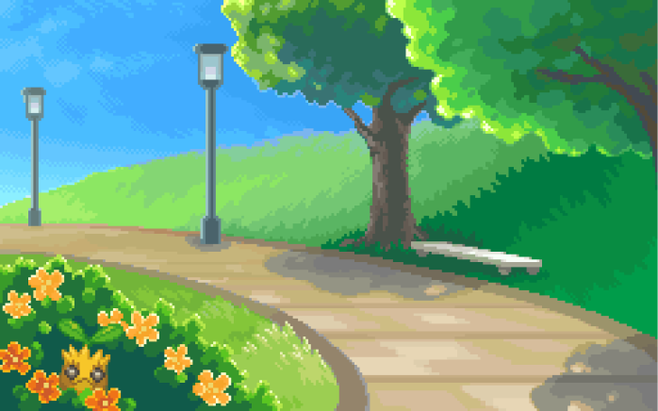
BIOME MAP
URBAN

Slide 7
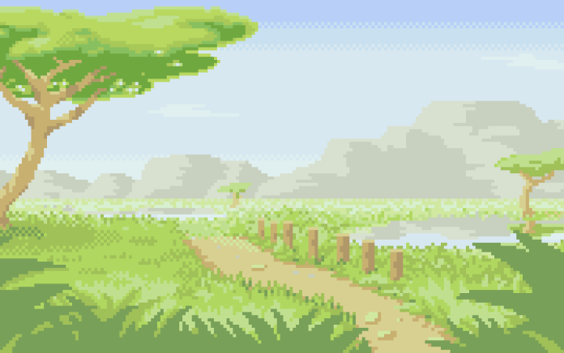
BIOME MAP
GRASSLAND

Slide 8
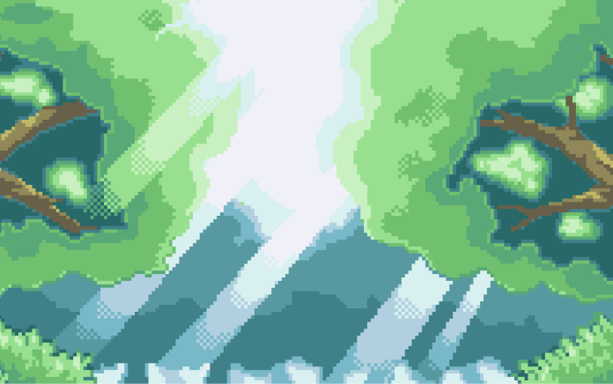
BIOME MAP
TEMPERATE FOREST

Slide 9
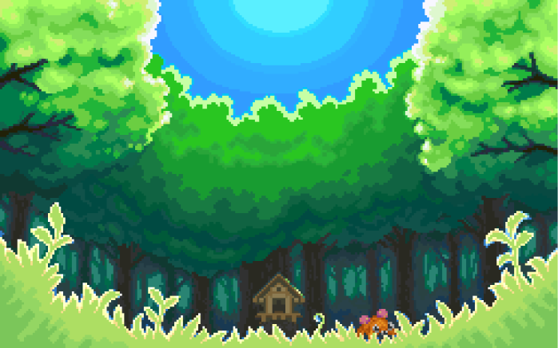
BIOME MAP
RAINFOREST

Slide 10
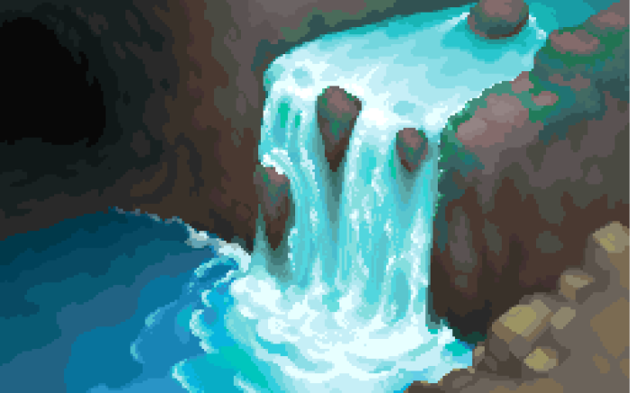
BIOME MAP
FRESHWATER

Slide 11
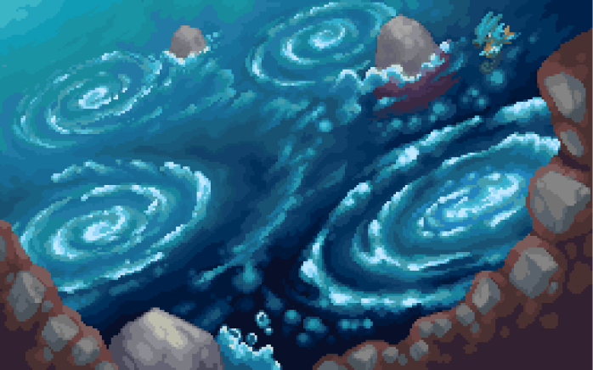
BIOME MAP
MARINE

Slide 12
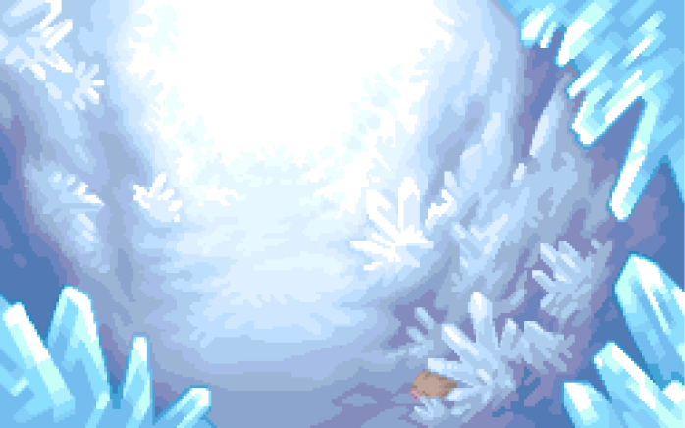
BIOME MAP
TUNDRA

Slide 13
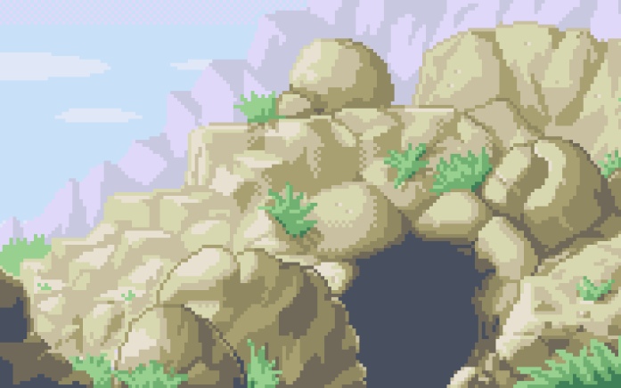
BIOME MAP
DESERT

Slide 14
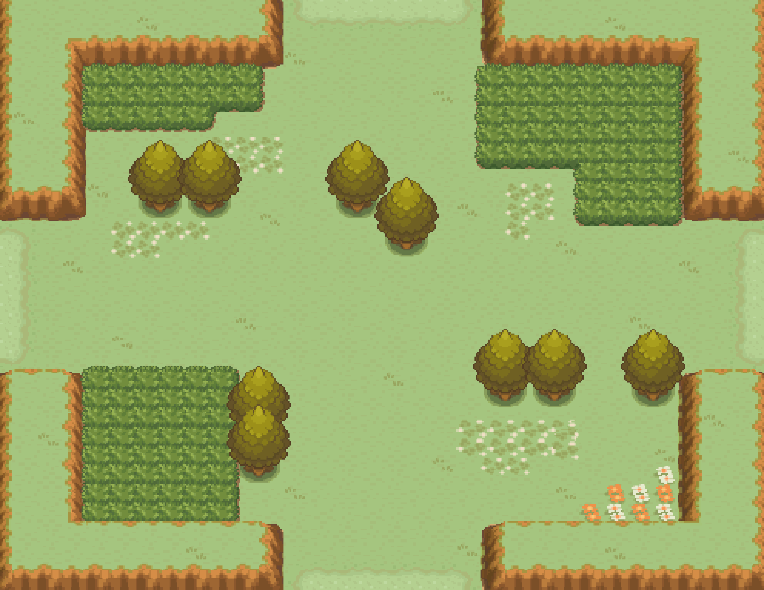




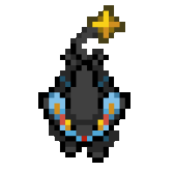
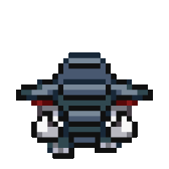
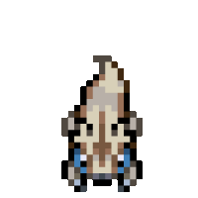
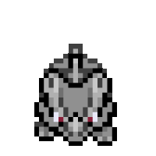
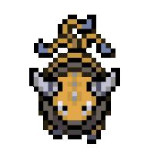
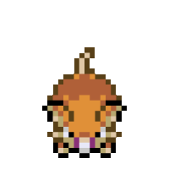

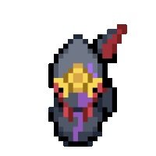
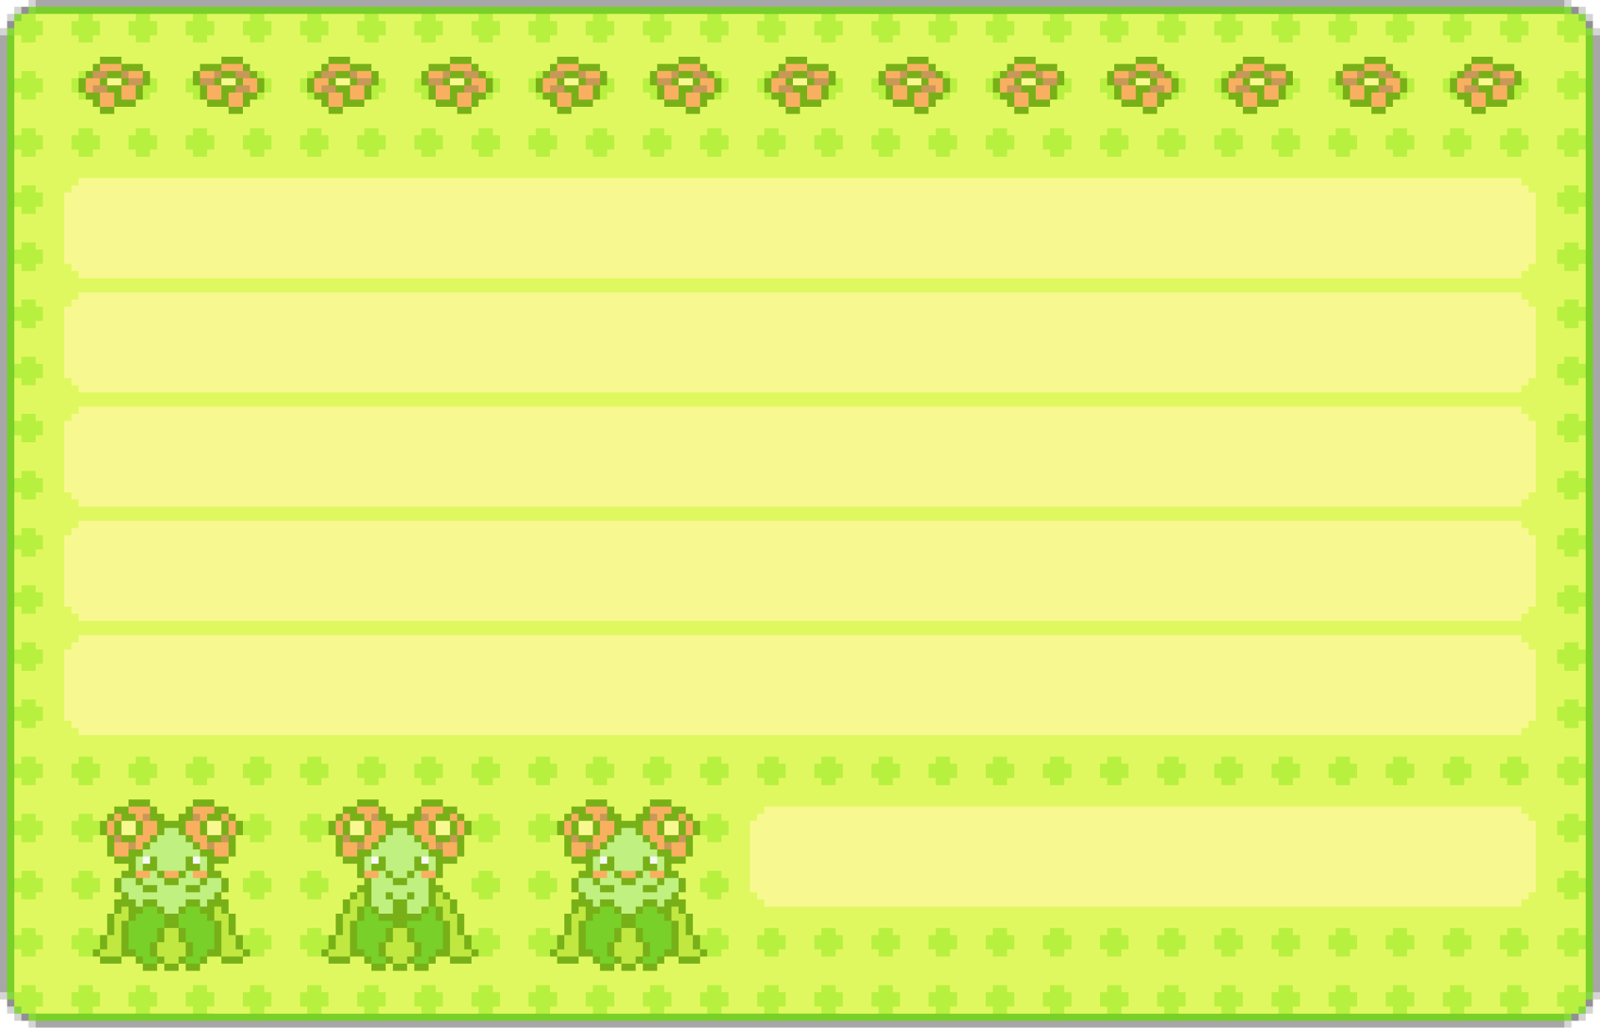
GRASSLAND
Snake
Mantis
Lion
Elephant
Prairie dog
Rhino
Bison
Rodent
Kangaroo
Snake
Open land covered in tall grass. Hot summers and cold winters, moderate rainfall. Lightning can ignite fires that burn away dead plants and promote new growth. This cycle of burning and regrowth helps maintain the ecology.

Slide 15
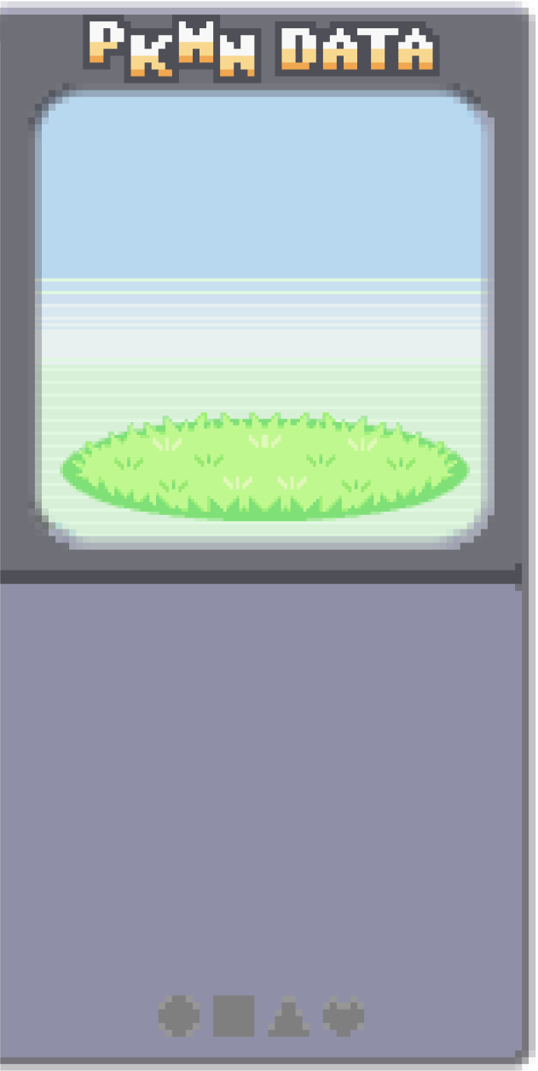
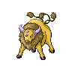
Snake
Mantis
GRASSLAND
Lion
Elephant
Prairie dog
Rhino
Bison’s muscular body helps them graze on tough grasses. Their hump on their shoulders stores fat and their herding instinct protects them from predators.
Bison
Rodent
Kangaroo
Snake
Open land covered in tall grass. Hot summers and cold winters, moderate rainfall. Lightning can ignite fires that burn away dead plants and promote new growth. This cycle of burning and regrowth helps maintain the ecology.

Slide 16
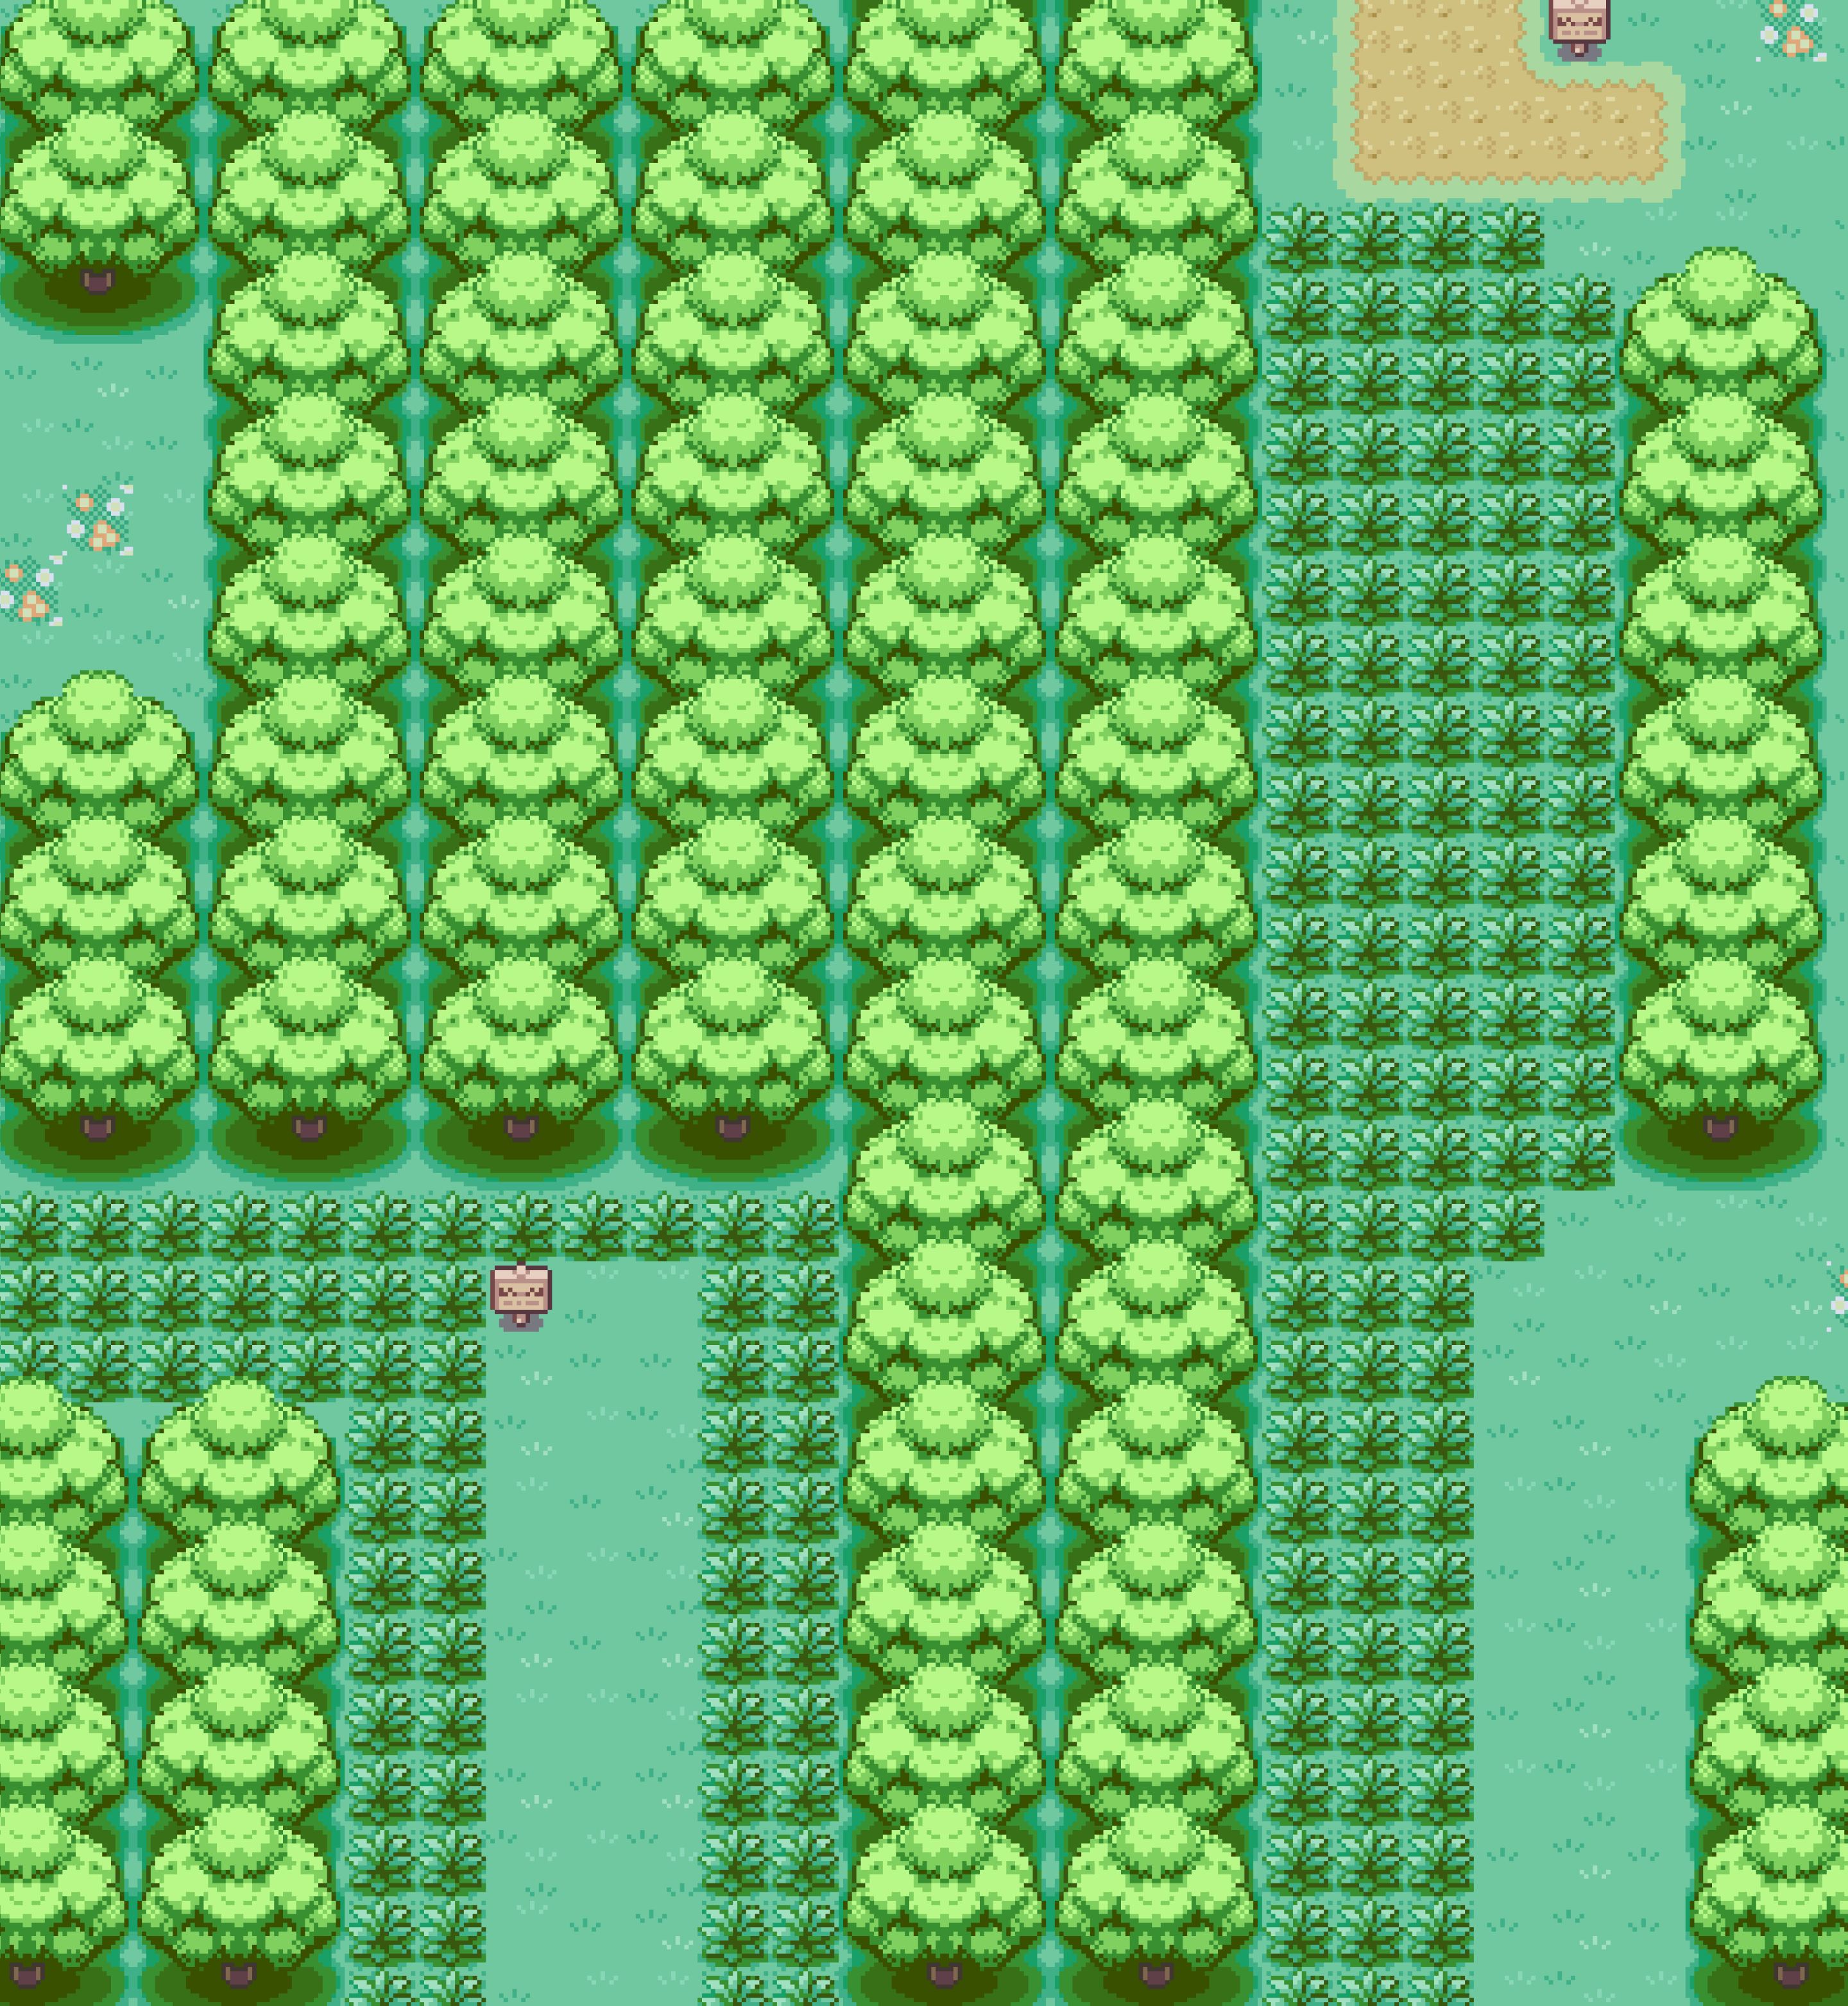
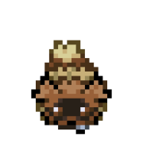



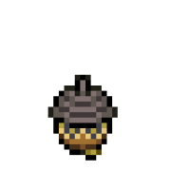
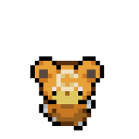



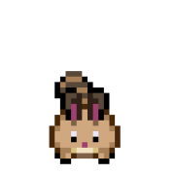
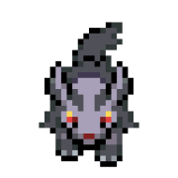
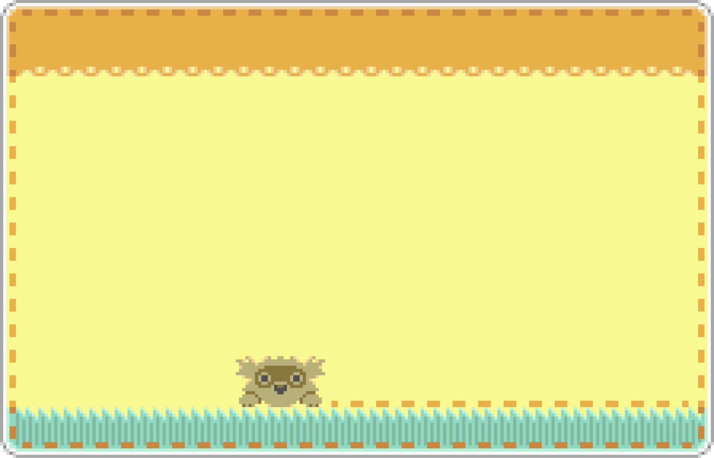
TEMPERATE FOREST
Racoon
Cougar
Worm
Owl
Acorn
Bear
Fungi
Ladybird
Grey wolf
Squirrel
Moderate temperatures and distinct seasons, with ample rainfall throughout the year.
Diverse array of deciduous trees that shed their leaves in the fall. Understory is rich with shrubs, ferns, and wildflowers.

Slide 17
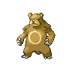
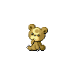
TEMPERATE FOREST
Racoon
Cougar
Worm
Owl
Acorn
Bears have sharp claws and a keen sense of smell, which help forage for food and navigate through dense vegetation. They hibernate when food is scarce to conserve energy.
Bear
Fungi
Ladybird
Squirrel
Grey wolf
Moderate temperatures and distinct seasons, with ample rainfall throughout the year.
Diverse array of deciduous trees that shed their leaves in the fall. Understory is rich with shrubs, ferns, and wildflowers.

Slide 18
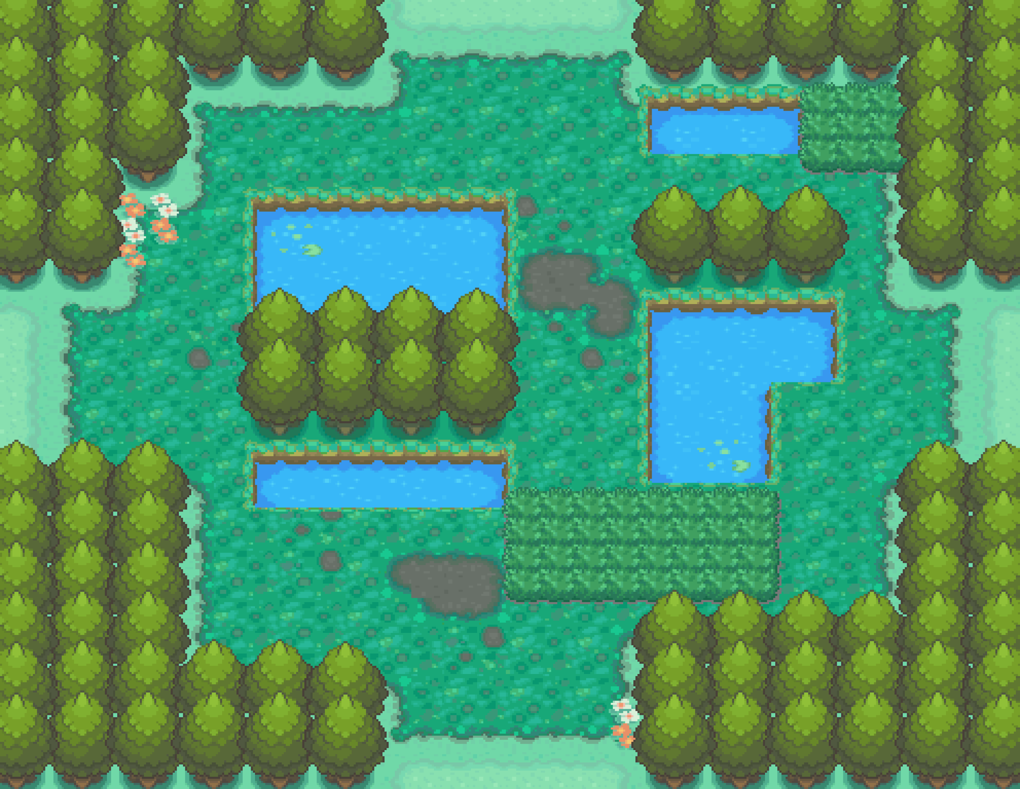



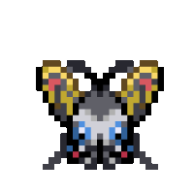

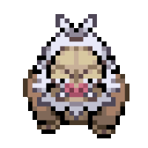
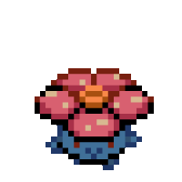

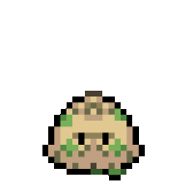
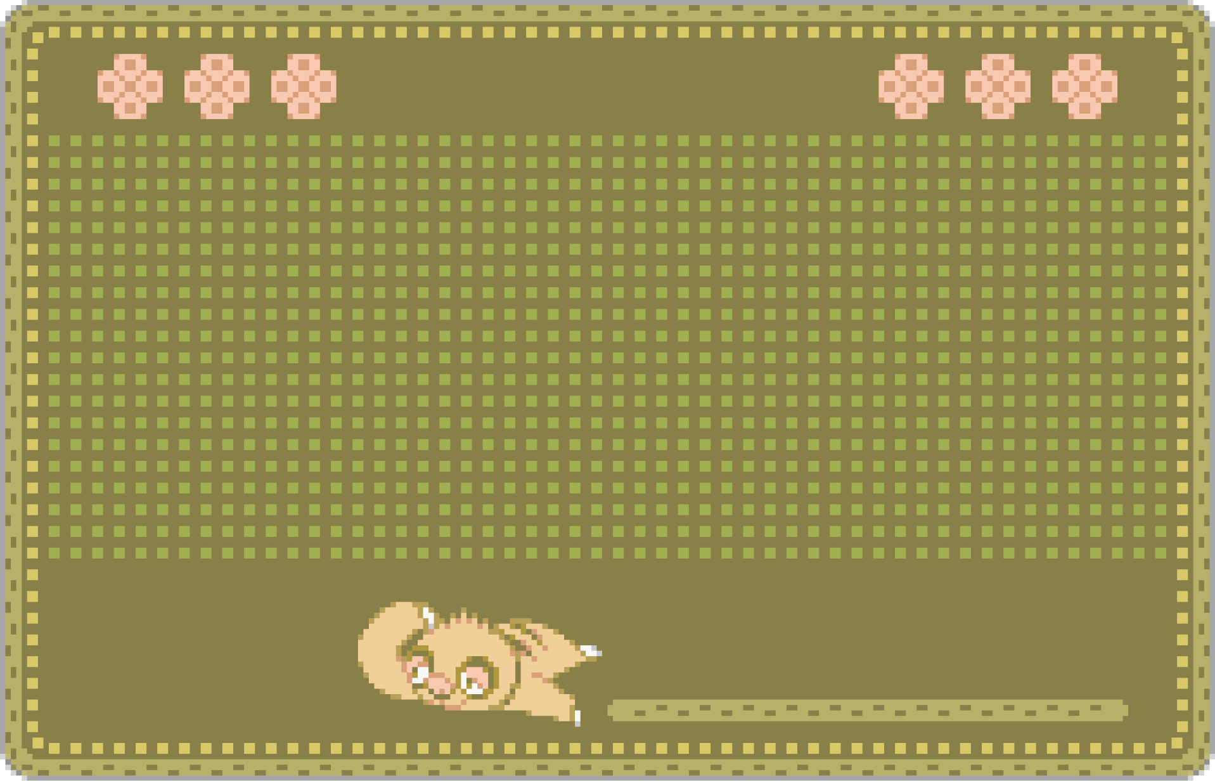
RAINFOREST
Beetle
Spider
Fungi
Butterfly
Sloth
Fungi
Monkey
Fungi
High levels of rainfall, warm temperatures, and dense vegetation. Canopy layer: towering trees, vines, epiphytes. Understory layer: smaller trees, shrubs, ferns. Forest floor: decomposing organic matter that provides fertile soil for new growth.

Slide 19

Beetle
Spider
Fungi
RAINFOREST
Butterfly
Sloth
Sloths adapt through their slow movement, specialized fur for camouflage and algae growth, and a low-energy diet of leaves that matches the nutrient-poor environment.
Fungi
Monkey
Fungi
High levels of rainfall, warm temperatures, and dense vegetation. Canopy layer: towering trees, vines, epiphytes. Understory layer: smaller trees, shrubs, ferns. Forest floor: decomposing organic matter that provides fertile soil for new growth.

Slide 20
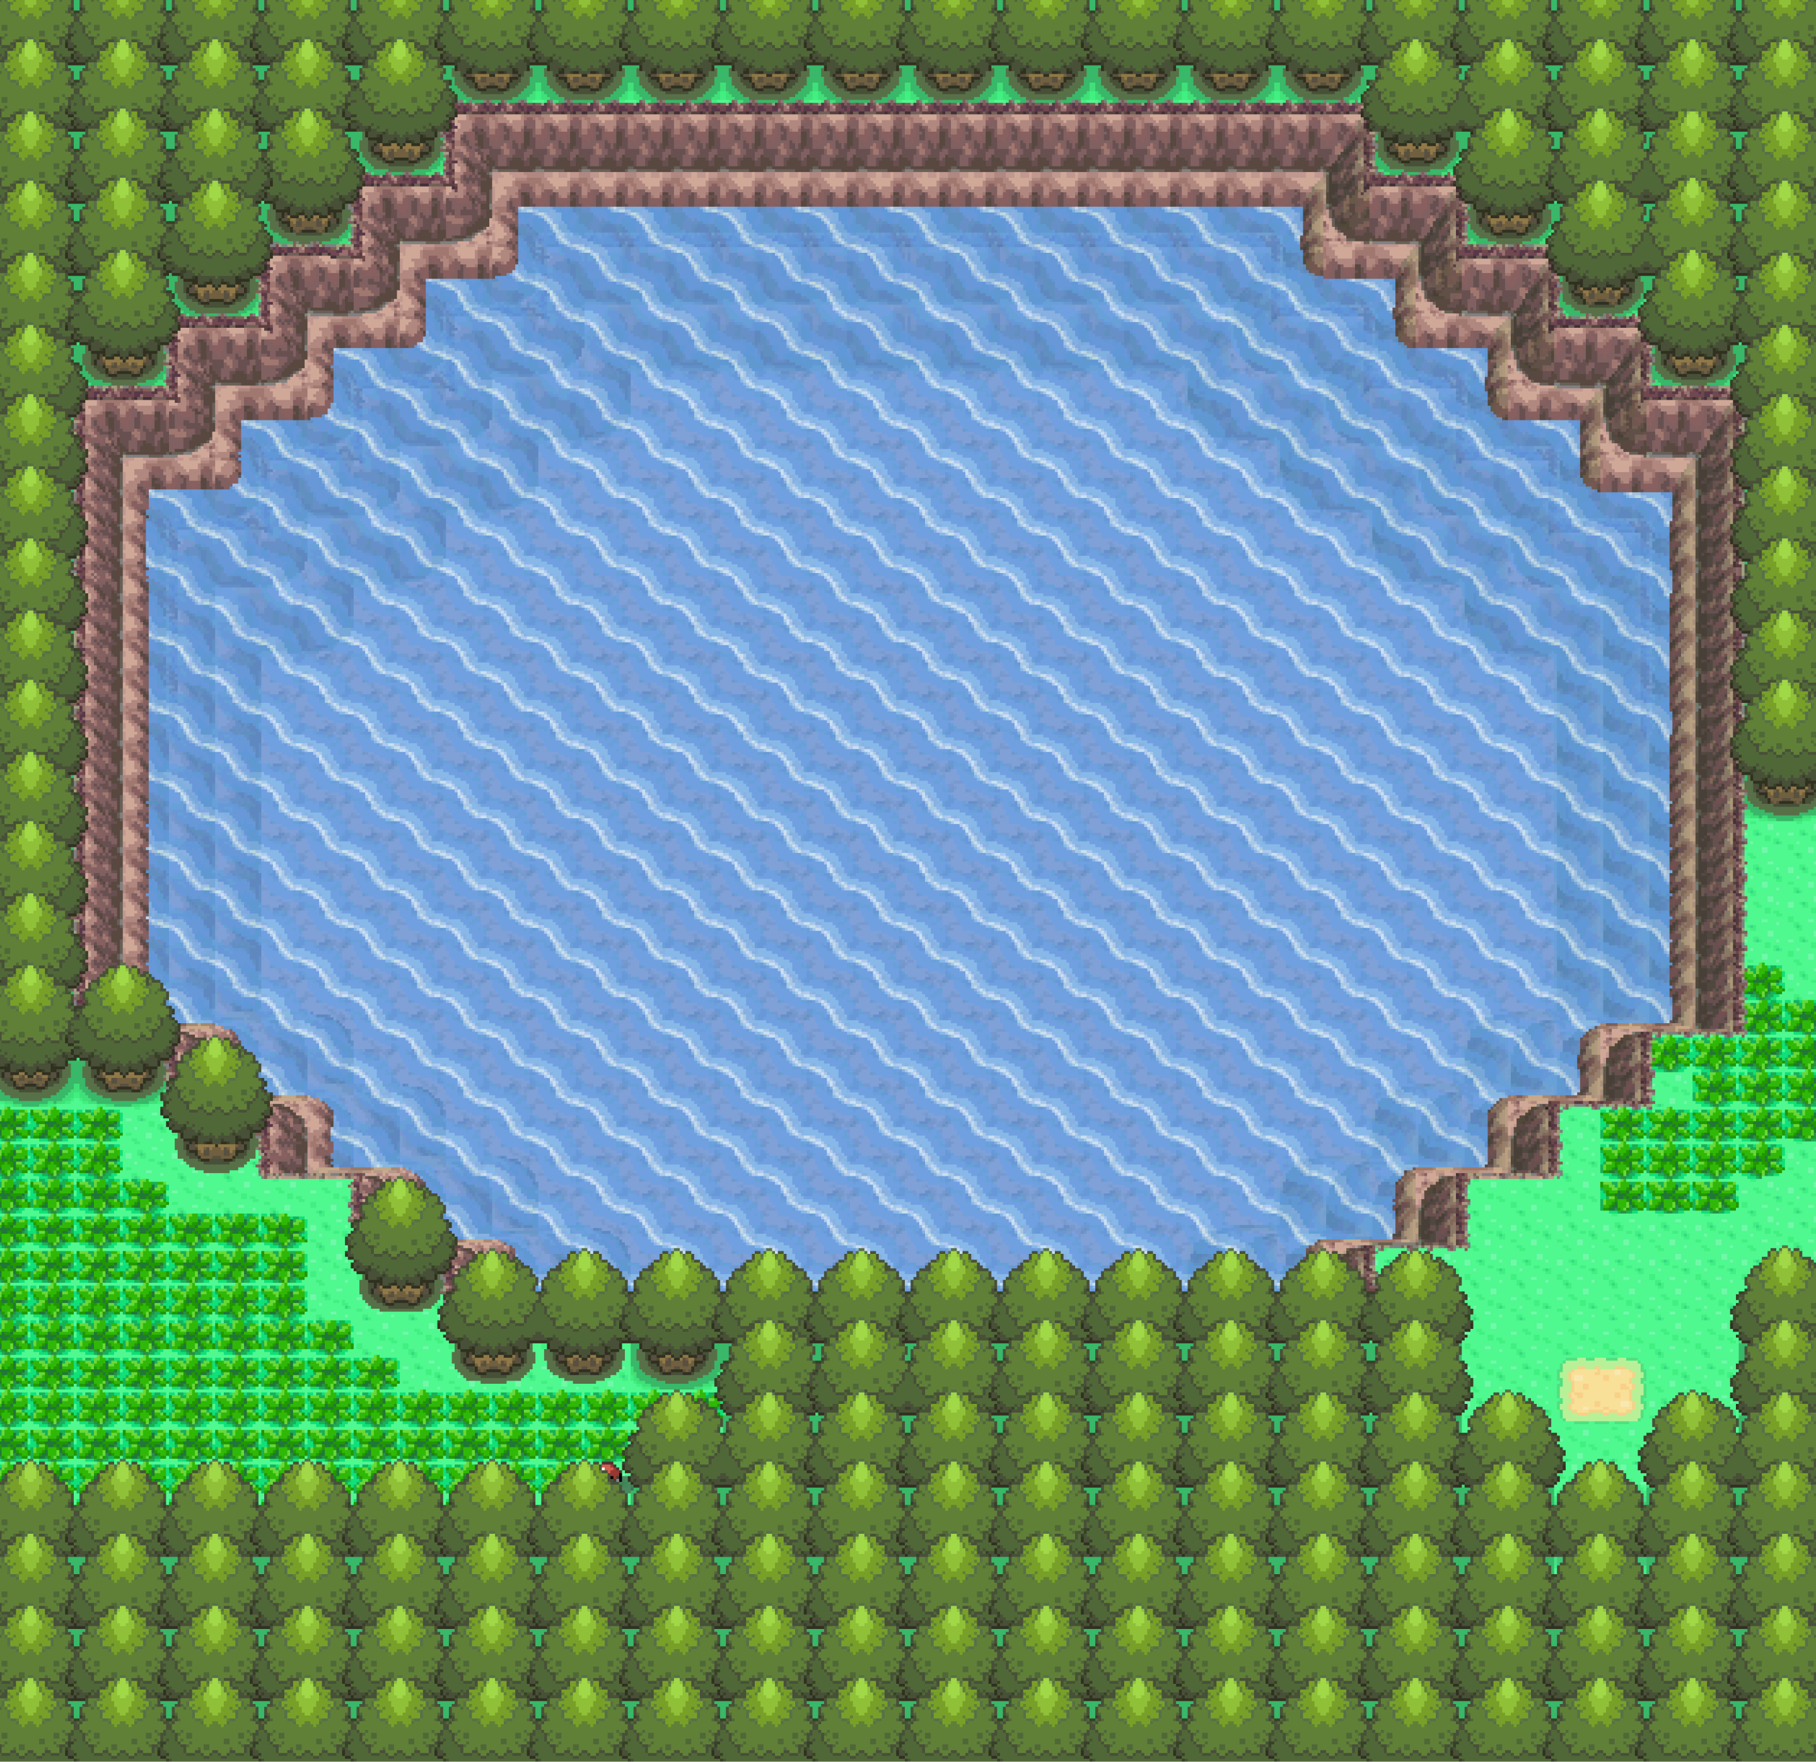

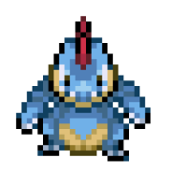
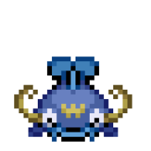
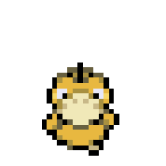
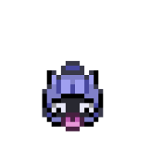

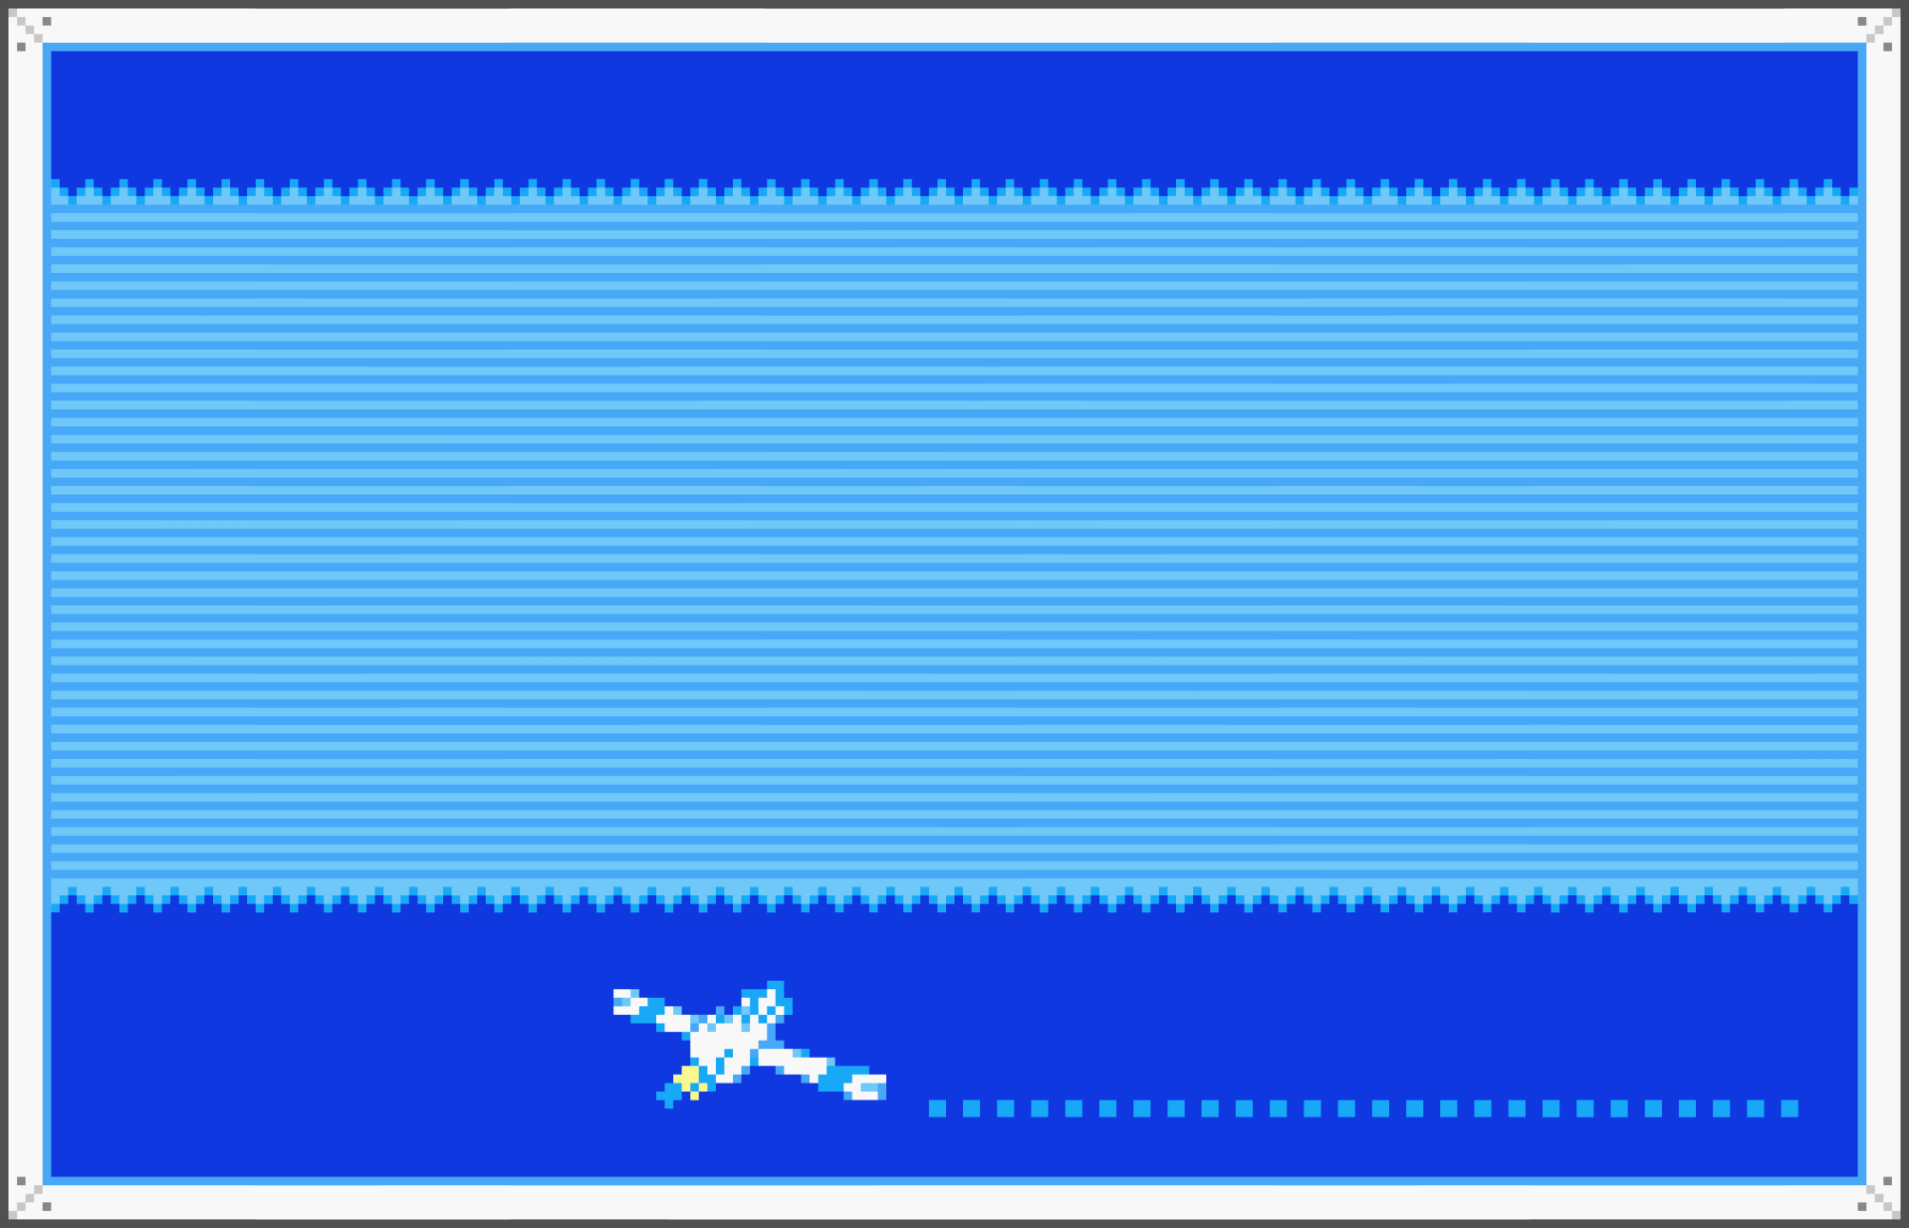
FRESHWATER
Tadpole
Alligator
Catfish
Duck
Mussel
Frog
Rivers, lakes, wetlands that provides clean drinking water for humans and animals. Under threat from pollution, habitat destruction, and climate change.

Slide 21
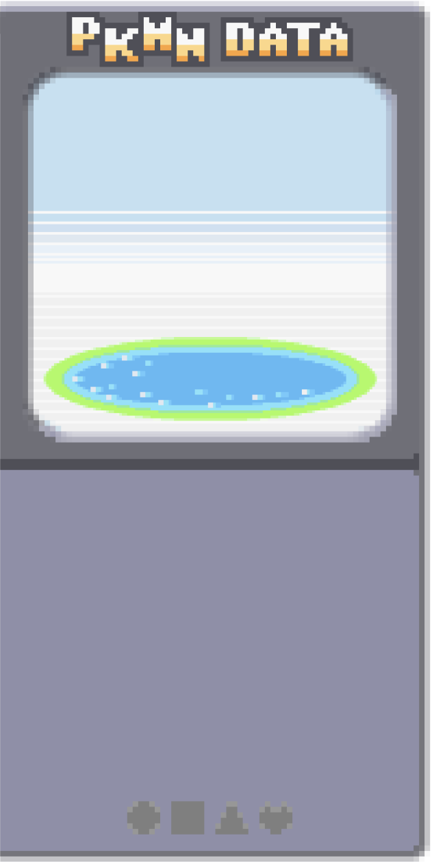
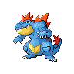
FRESHWATER
Tadpole
Alligators have specialised kidneys that allow them to excrete excess salt and retain water. Their respiratory system allows them to breathe while submerged.
Alligator
Catfish
Mussel
Duck
Rivers, lakes, wetlands that provides clean drinking water for humans and animals. Under threat from pollution, habitat destruction, and climate change.
Frog

Slide 22
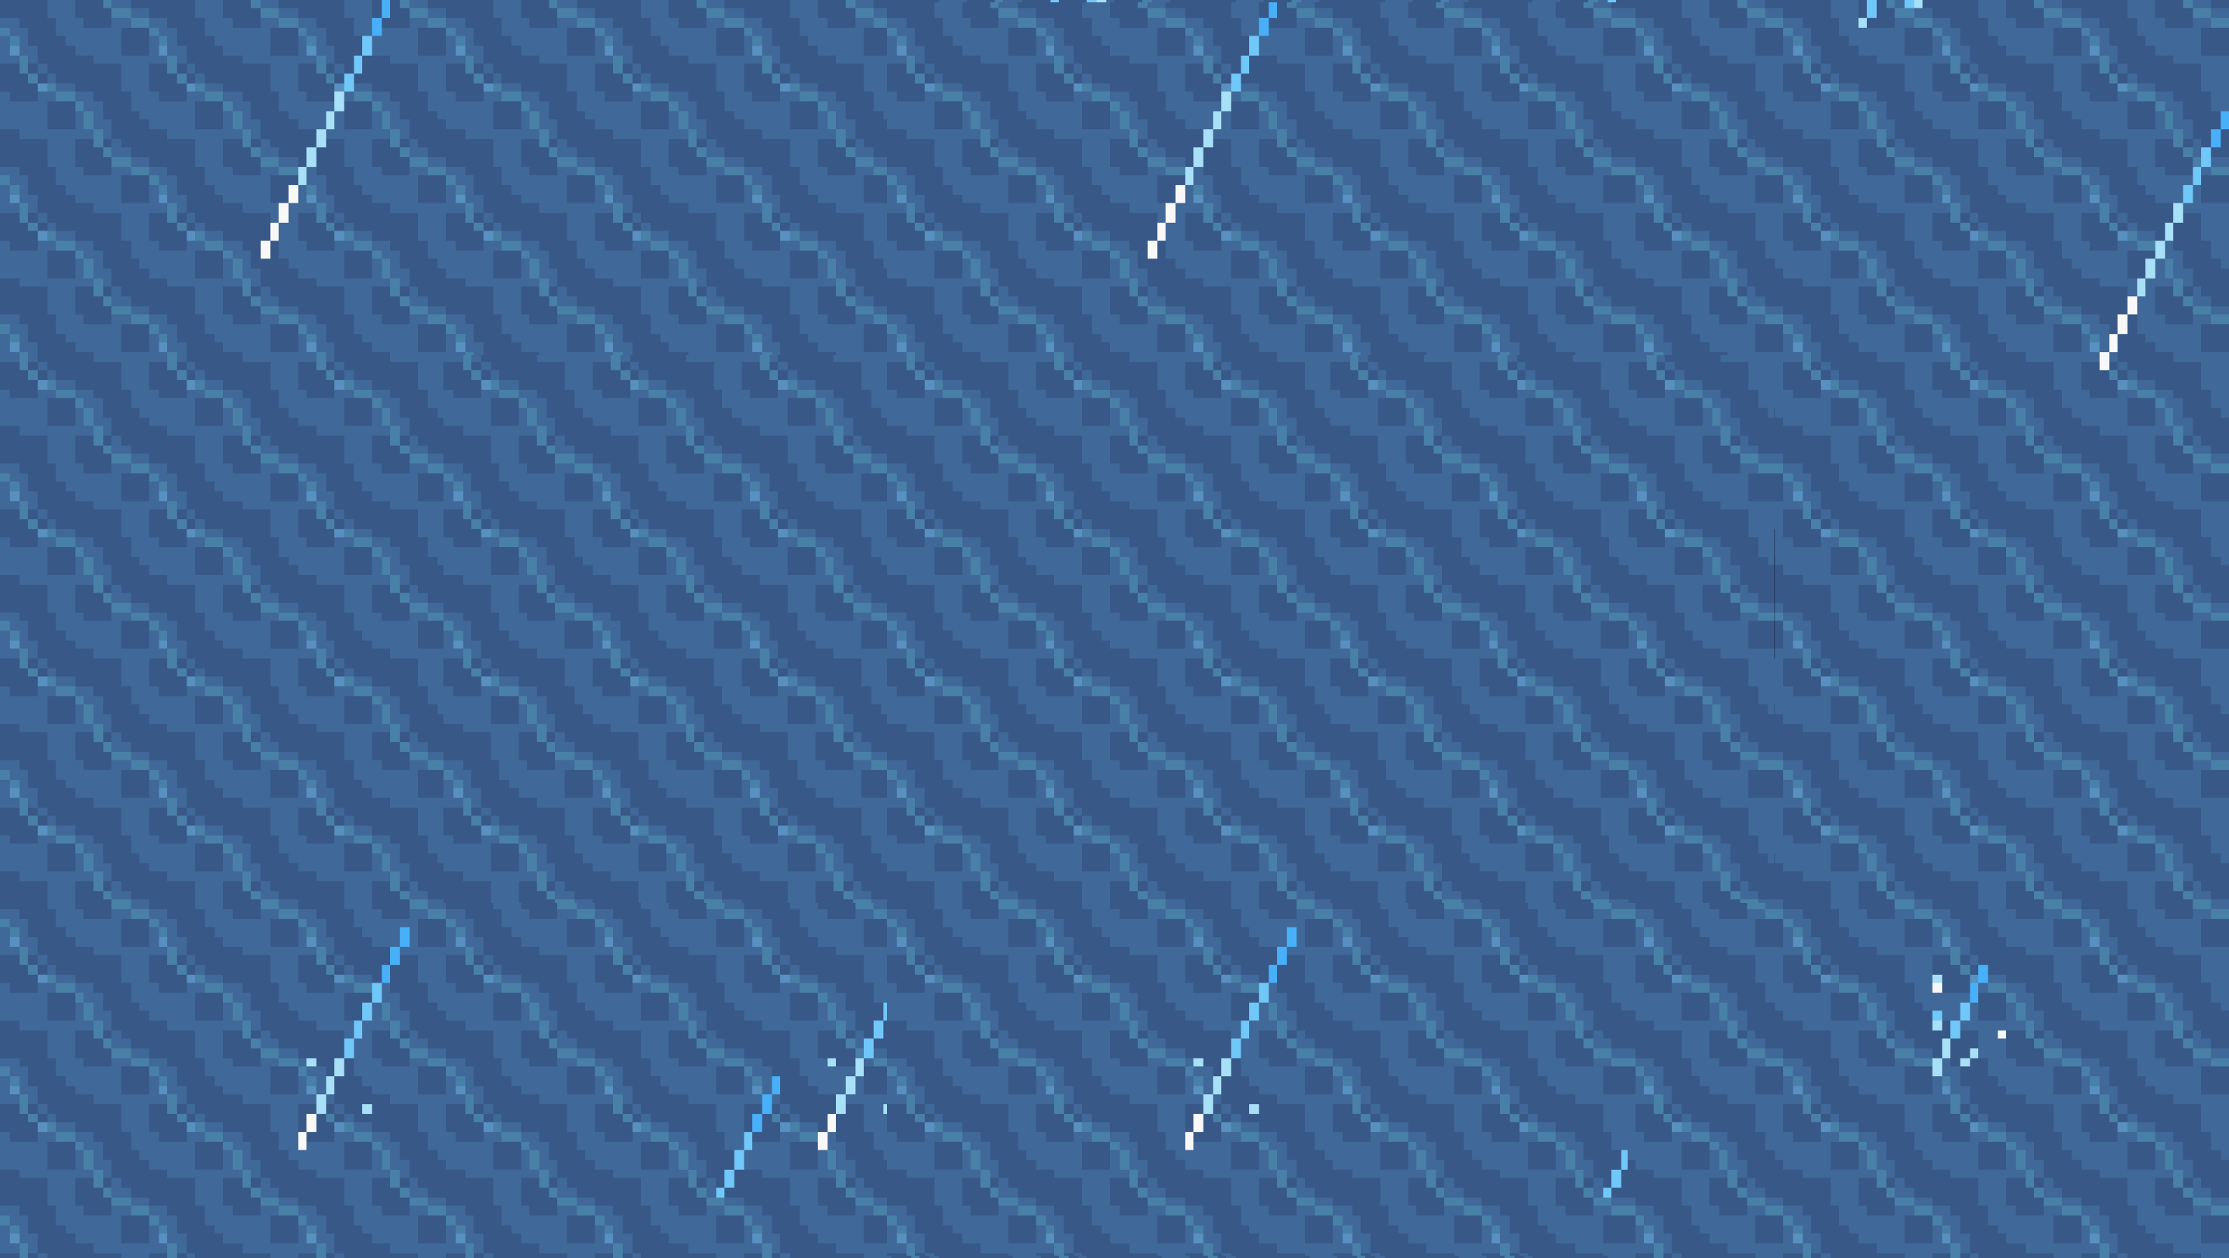
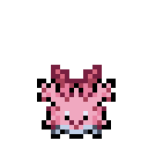


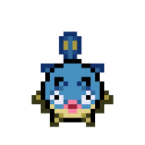
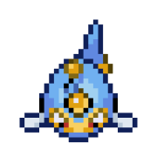

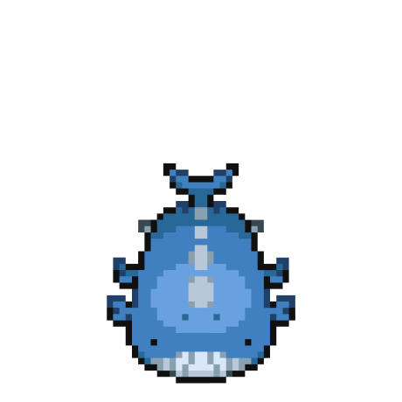

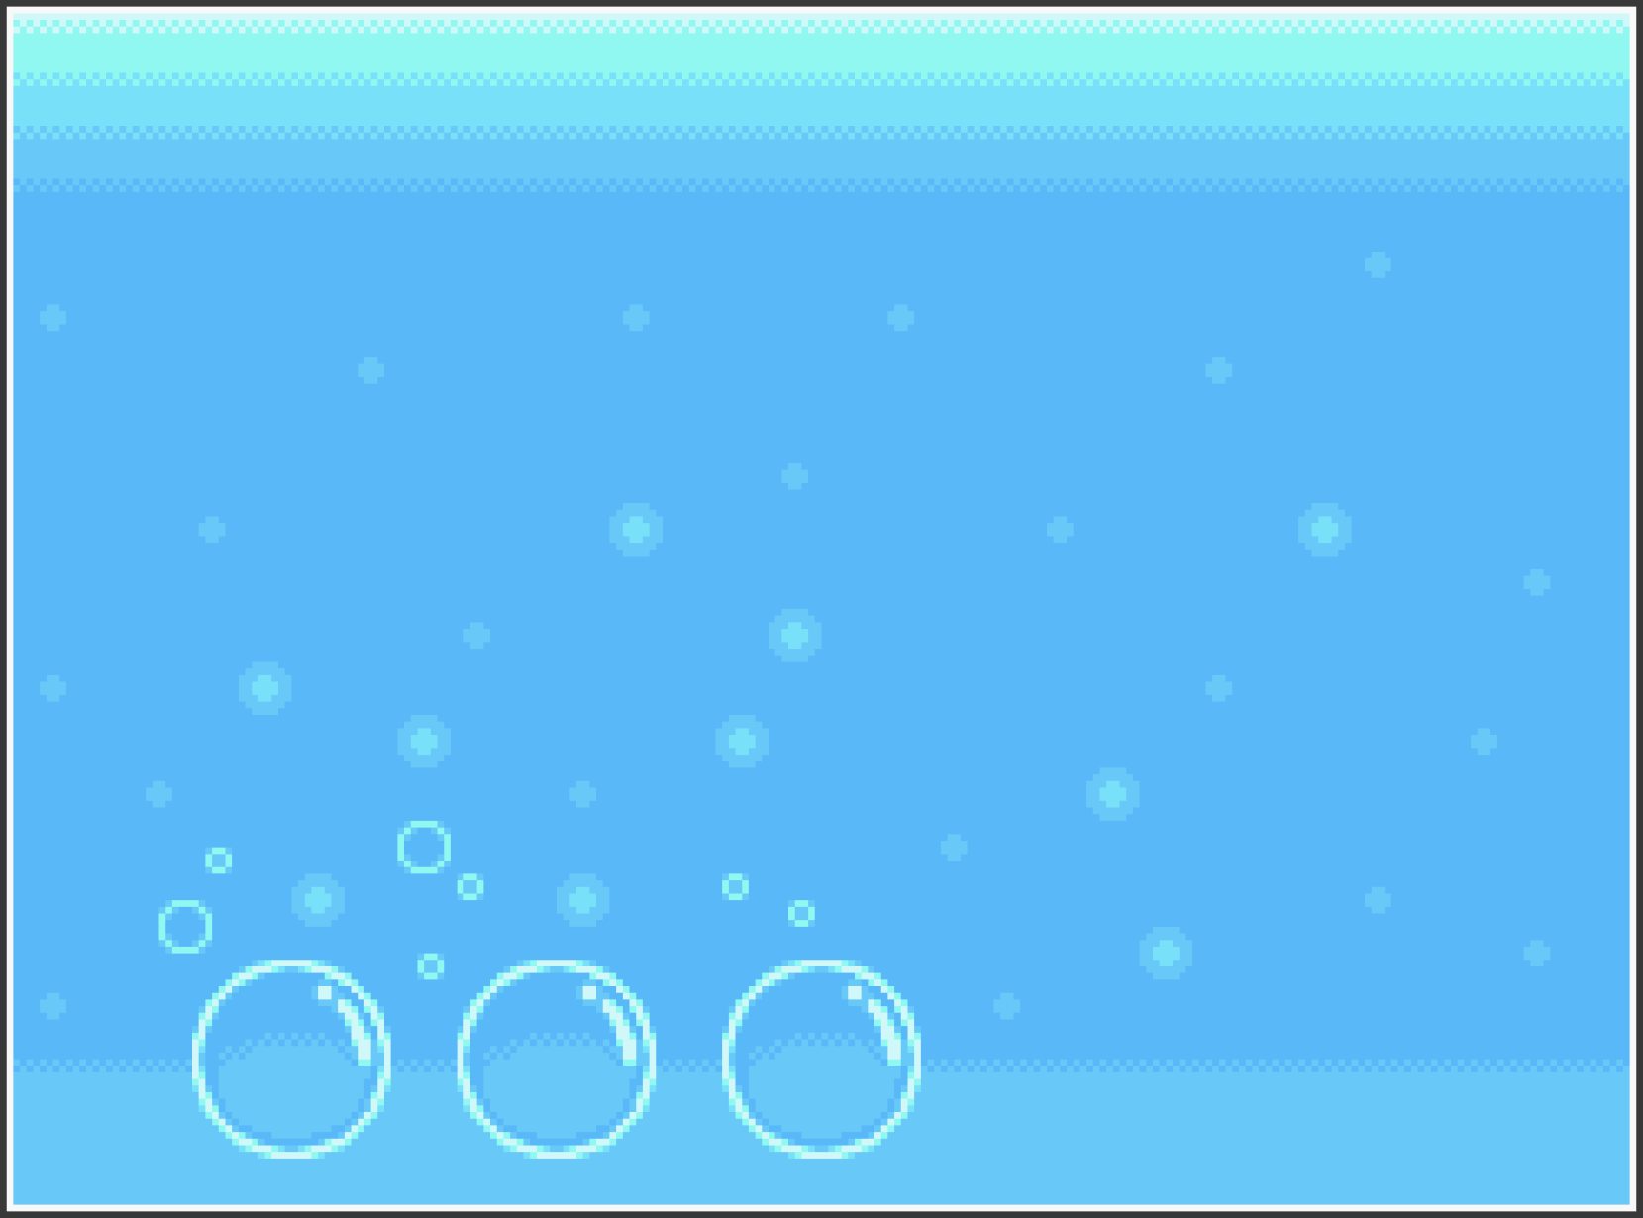
MARINE
Coral
Shark
Octopus
Pufferfish
Anglerfish
Manatee
Starfish
Whale
Covers more than 70% of the Earth's surface, making it the largest ecosystem on our planet. Some areas experiencing warm tropical waters and others enduring freezing temperatures in polar regions.

Slide 23
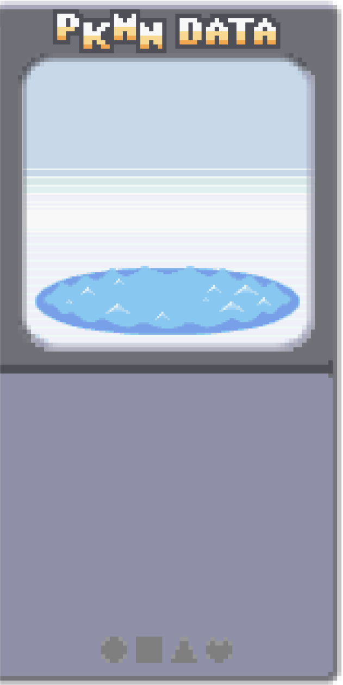

Coral
MARINE
Shark
Octopus
Pufferfish
Anglerfish
Manatee
Anglerfish’s bioluminescent lure attract prey in the dark depths. Their a large mouth and expandable stomach accommodate large meals in the nutrient poor environment.
Starfish
Whale
Covers more than 70% of the Earth's surface, making it the largest ecosystem on our planet. Some areas experiencing warm tropical waters and others enduring freezing temperatures in polar regions.

Slide 24
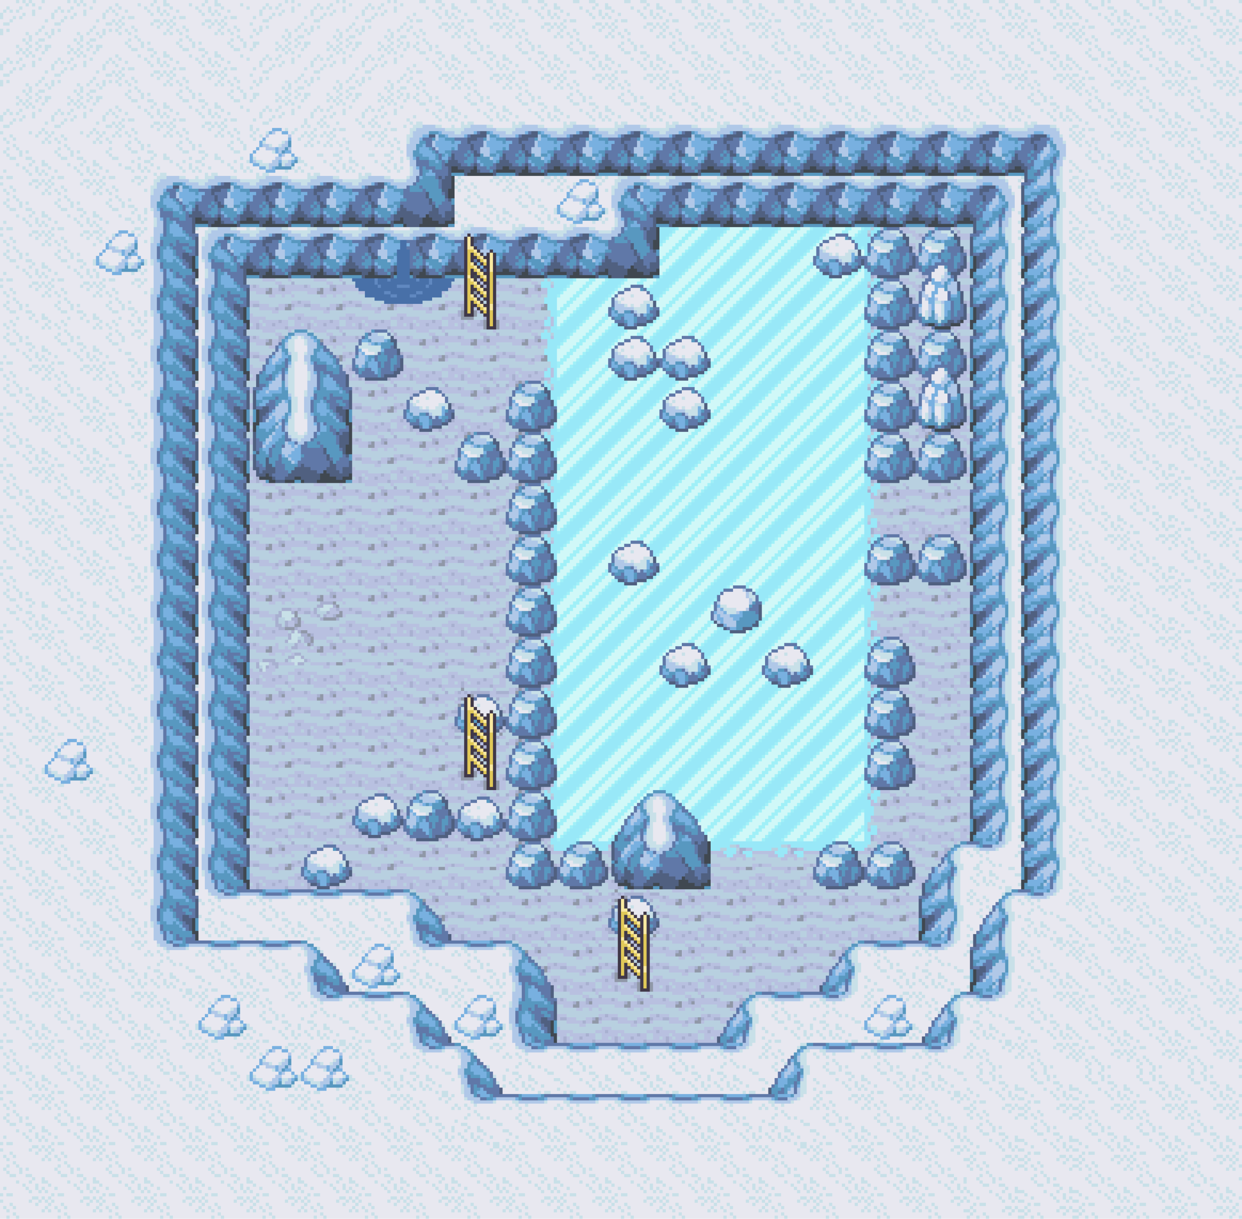








TUNDRA
Penguin
Sealion
Seal
Walrus
Reindeer
Artic fox
Freezing temperatures, high winds, and little precipitation. Permafrost: a layer of frozen soil that never thaws. Not have much biodiversity and vegetation is simple, including shrubs, grasses, mosses, and lichens.

Slide 25


TUNDRA
Penguin
Sealion
Seal
Walruses adapt with blubber for insulation and buoyancy, long tusks for digging through ice and hurling themselves onto ice floes, and whiskers that locate prey in the dark and murky waters.
Walrus
Artic fox
Reindeer
Freezing temperatures, high winds, and little precipitation. Permafrost: a layer of frozen soil that never thaws. Not have much biodiversity and vegetation is simple, including shrubs, grasses, mosses, and lichens.

Slide 26








DESERT
Camel
Pangolin
Cactus
Antlion
Larva
Scorpion
Scorching temperatures, lack of rainfall, and sparse vegetation.
Cacti, succulents, and other plants have specialized adaptations for storing water.

Slide 27

DESERT
Camel
Cactus
Pangolin
Antlion
Antlions bury themselves in cone-shaped sand traps, waiting for unsuspecting prey to fall into their traps, and using their long, sickle-shaped jaws to capture and consume their prey.
Larva
Scorpion
Scorching temperatures, lack of rainfall, and sparse vegetation.
Cacti, succulents, and other plants have specialized adaptations for storing water.

Slide 28







URBAN

Slide 29




URBAN
Bird
Butterfly
Bee
Urban ecology faces space constraints. To create green spaces and biomes, cities can consider vertical and rooftop gardens as solutions to maximize limited land.

Slide 30

URBAN
Green spaces can improve mental well-being by providing a relaxing environment in a bustling city. Nature reduces stress and improves mood.

Slide 31




URBAN
Tapir
Pangolin
Yelloweye Rockfish
Axolotl
Endangered species are vulnerable to extinction due to habitat loss, poaching, and climate change. Protecting them is crucial for maintaining ecosystem balance.

Slide 32




Which biome has a layer of permafrost?
GENGAR
3
NIDORINO
6
50/50
MARINE
TUNDRA
RAINFOREST
DESERT

